Slide 1

ITP 341
REST and
Network Requests

Slide 2
Application Programming Interface (API)
A specification used as an interface by software components to communicate with each other
Usually related to a software library
May also be related to a software framework
May also be an implementation of a protocol
Publishing APIs has allowed web communities to create an open architecture for sharing content and data between communities and applications

Slide 3
REST
Representational state transfer (REST)
Software architecture for distributed systems such as the World Wide Web
Allows different pieces of software to communicate with one another

Slide 4
RESTful
Services that conforming to the REST constraints is referred to as being RESTful
RESTful web service (or RESTful web API) is a simple web service implemented using HTTP and the principles of REST

Slide 5
REST Services
Many web sites provide REST Web Services
Examples
Search (e.g. Google Custom Search)
Geolocation (e.g Yahoo’s Placefinder)
Photo Sharing (e.g. Yahoo’s Flickr, Google’s Picasa)
Social Networking (e.g. Facebook, Twitter, MySpace)
Mapping (e.g. Google Maps)
Many limit daily usage by a single website, and require payment when the thresholds are breached

Slide 6

Facebook
https://developers.facebook.com/mobile/
Things you can do:
Login with Facebook
Fetch User Data
Publish to Feed
Send Requests

Slide 7

Twitter
https://dev.twitter.com
Embedded Timelines
Make it easy to syndicate any public Twitter timeline to your website with one line of code
You can embed a timeline for Tweets from an individual user, a user’s favorites, Twitter lists, or any search query or hashtag
Twitter Cards
Attach media experiences to Tweets that link to your content
Embedded Tweets
Allows websites to generate copy and paste-able HTML markup to render a Tweet on any third-party website

Slide 8
Twitter
REST API
https://dev.twitter.com/docs/api
Provides simple interfaces for most Twitter functionality
Streaming APIs
https://dev.twitter.com/docs/streaming-apis
A family of powerful real-time APIs for Tweets and other social events

Slide 9
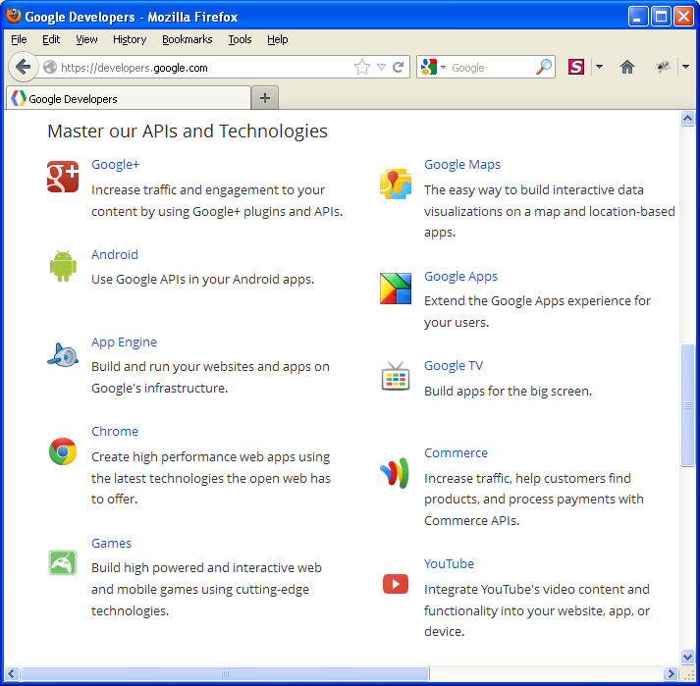
Google APIs
Available at:
http://developers.google.com
APIs available for:
Google+
Android
App Engine
Chrome
Games
Google Maps
Google Apps
Google TV
Commerce
YouTube

Slide 10

Twilio
http://www.twilio.com
Provides web service API
Allows your app to make and receive phone calls
Allows your app to send and receive text messages
Billed based on usage

Slide 11

The Cloud

Slide 12
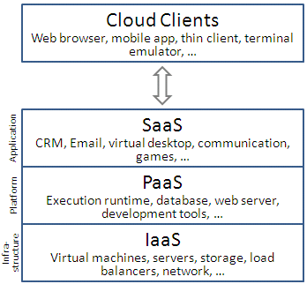
Cloud Computing Layers

Slide 13
Cloud Computing
SaaS – software as a service
"on-demand software" or "application service providers" (ASPs)
Software and associated data are hosted on the cloud
PaaS – platform as a service
Computing platform including operating system, programming language execution environment, database, and web server
IaaS – infrastructure as a service
Offer computers - physical or virtual machines - and other resources

Slide 14
Cloud Computing
BaaS (backend as a service)
Provide web and mobile applications with backend cloud storage and related features
Services are provided via the use of custom software development kits (SDKs) and application programming interfaces (APIs)

Slide 15



BaaS (backend as a service)
Common features
Database
User management / login
Push notifications
Social networking integration
Tools
Firebase
StackMob
Kinvey

Slide 16
REST Philosophy
Statelessness
Every API is treated as a new request, and no client context is remembered on the server
Resource identification
Done through URLs
Cacheability
Allows clients to cache responses based on the URL

Slide 17
RESTful Web Services
The base URI for the web service, such as http://example.com/resources/
The set of operations supported by the web service using HTTP methods (e.g., GET, PUT, POST, or DELETE)
The API must be hypertext driven

Slide 18
HTTP Methods ("Verbs")
Method | Operation performed on server | Quality
GET | Read a resource. | Safe (doesn’t modify resource)
PUT | Insert a new resource or update if the resource already exists. | Idempotent (calling it multiple times is the same as calling it once—think a=4)
POST | Insert a new resource. Also can be used to update an existing resource. | Calling it multiple times keeps changing result—think a++
DELETE | Delete a resource . | Idempotent (calling it multiple times is the same as calling it once—think a=4)
OPTIONS | List the allowed operations on a resource. | Safe (doesn’t modify resource)
HEAD | Return only the response headers and no response body. | Safe (doesn’t modify resource)
http://www.drdobbs.com/web-development/restful-web-services-a-tutorial/240169069?pgno=2

Slide 19
Accessing REST Services
Direct URL
Response provided in JSON, XML, or other
Library-based APIs
Include Gradle dependency to access source, or
Include compiled library SDK
One or both options may be provided

Slide 20
REST Services
Many of these services now require or include OAuth user authentication
Oauth is a standard for clients to access server resources on behalf of a resource owner
E.g. see http://en.wikipedia.org/wiki/OAuth

Slide 21
REST Response
Response from a RESTful server is usually sent in a uniform, agreed-upon format, usually to decouple the client/server interface
The client app communicates with a RESTful server through this agreed-upon data exchange format
The most commonly used formats are JSON and XML

Slide 22
JavaScript Object Notation (JSON)
Lightweight text-data interchange format
"Self-describing" and easy to understand
http://www.w3schools.com/json/
{
"employees": [
{ "firstName":"Jean-Luc" , "lastName":"Picard" },
{ "firstName":"Beverly" , "lastName":"Crusher" },
{ "firstName":"Data" , "lastName":"" }
]
}

Slide 23
eXtensible Markup Language (XML)
Designed to transport and store data
Uses tags
Has a root node
http://www.w3schools.com/xml/default.asp
<?xml version="1.0" encoding="UTF-8"?>
<note>
<to>Geordi</to>
<from>Data</from>
<heading>Reminder</heading>
<body>Feed my cat Spot</body>
</note>

Slide 24
Networking in Android
All networking must be performed on a secondary thread
If network action occurs on main thread, your app will crash
This is by design
Why do you think this is?
Notes:
Network calls are very slow and Android wants to maintain the user experience

Slide 25
Approaches to Networking in Android
Using Socket connections
Using HttpURLConnection
Using Third-party libraries
You may come across AndroidHttpClient. It is since been deprecated so shouldn't be used.

Slide 26
1. Sockets
Low-level (avoid unless you have a reason)
Create a socket object by passing host name and port address
Socket socket = new Socket("www.usc.edu", 80);
Get socket’s inputstream
InputStream is = socket.getInputStream();
Read using BufferedReader

Slide 27
2. HttpURLConnection
Provides more flexibility than Sockets
Create a URL object from String url
URL url = new URL("www.usc.edu");
Open HttpURLConnection from URL object
HttpURLConnection hCon = (HttpURLConnection)url.openConnection();

Slide 28
2. HttpURLConnection
Get InputStream from HttpURLConnection
Provides a readable source of bytes
InputStream is = hCon.getInputStream();
Wrap InputStream with InputStreamReader
Input stream of bytes is converted to stream of characters
Buffer reading operation to improve efficiency
BufferedReader reader = new
BufferedReader(new InputStreamReader(is));

Slide 29
2. HttpURLConnection
Thus…
URL url = new URL("www.usc.edu");
HttpURLConnection httpURLConnection = (HttpURLConnection) url.openConnection();
InputStream is = httpURLConnection.getInputStream();
BufferedReader reader = new BufferedReader(new InputStreamReader(is));
Notes:
InputStream – readable source of bytes
inputStreamReader - A class for turning a byte stream into a character stream. Data read from the source input stream is converted into characters by either a default or a provided character converter
BufferedReader - Wraps an existing Reader and buffers the input. Expensive interaction with the underlying reader is minimized, since most (smaller) requests can be satisfied by accessing the buffer alone.

Slide 30
2. HttpURLConnection
Read all characters into String data
Appending String is inefficient so use StringBuilder
StringBuilder response = new StringBuilder("");
String line;
while ((line = reader.readLine()) != null) {
response.append(line);
}

Slide 31
2. HttpURLConnection
Read all characters into String data
Appending String is inefficient so use StringBuilder
StringBuilder response = new StringBuilder("");
String line;
while ((line = reader.readLine()) != null) {
response.append(line);
}

Slide 32
2. HttpURLConnection
Surround it all with try…catch and you’re done!

Slide 33
2. HttpURLConnection
StringBuilder response = new StringBuilder("");
try {
URL url = new URL(params[0]);
HttpURLConnection httpURLConnection = (HttpURLConnection) url.openConnection();
InputStream is = httpURLConnection.getInputStream();
BufferedReader reader = new BufferedReader(new InputStreamReader(is));
String line;
while ((line = reader.readLine()) != null)
response.append(line);
} catch (IOException e) {
e.printStackTrace();
}

Slide 34
3. Third-Party REST Libraries
Libraries typically handle
All network connections
File downloading
Thread issue

Slide 35
3. Third-Party REST Libraries
Volley
https://developer.android.com/training/volley
Retrofit
http://square.github.io/retrofit/
Many others

